Slide 1
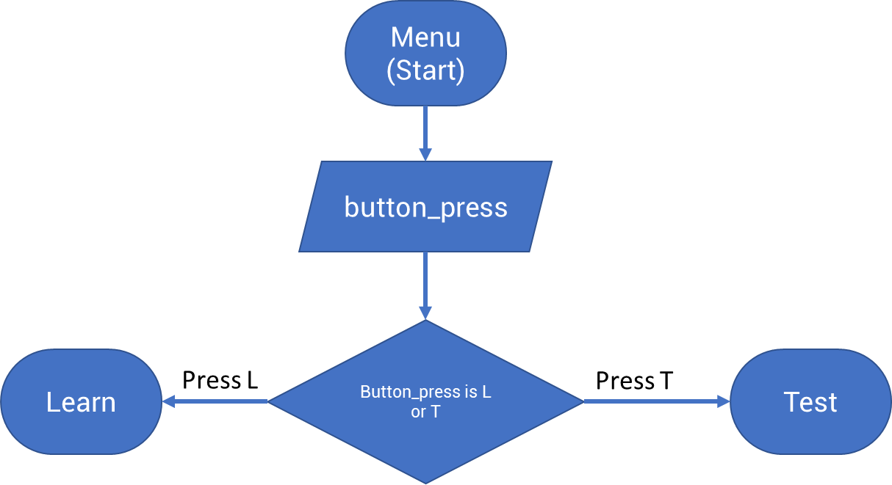
Menu
(Start)
Notes:
Button_press is basically a range of buttons.
similar to v_count/h_count in the vga modules I presume
button_press
Learn
Button_press is L or T
Test
Press L
Press T

Slide 2
Test
(Start)
Menu
(Start)
Score: 0
Timer_start: 10
button_press
Menu
(Start)
Check if button_press in range for Play or Back
back
play
R <- Randomizer()
Audio_playback(R)
Play audio
Show ”Ouch, you guessed wrong! /❌/ 👎for 2 secs
Time_up = 1?
Show congrats, you guessed right! / ✔/👍
for 2 secs
Yes
No
button_press
Button_press corresponds to R (played back file)
No
Yes
Score increment (Hi_enable = 1’b1)

Slide 3
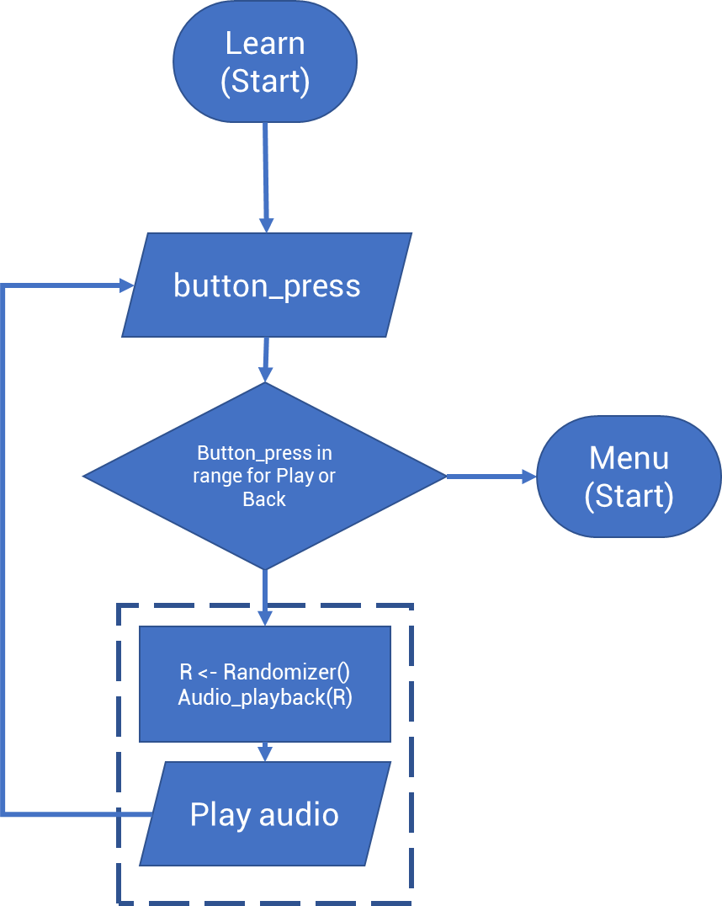
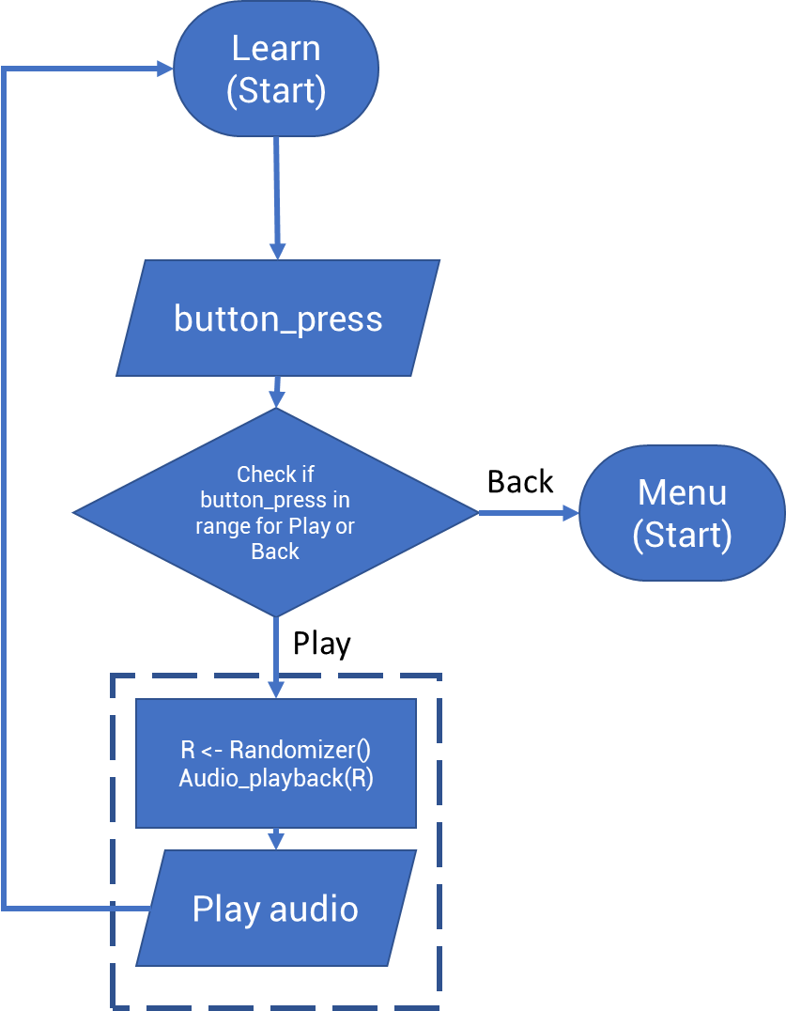
Menu
(Start)
Learn
(Start)
button_press
Check if button_press in range for Play or Back
Menu
(Start)
Back
Play
R <- Randomizer()
Audio_playback(R)
Play audio

Slide 4

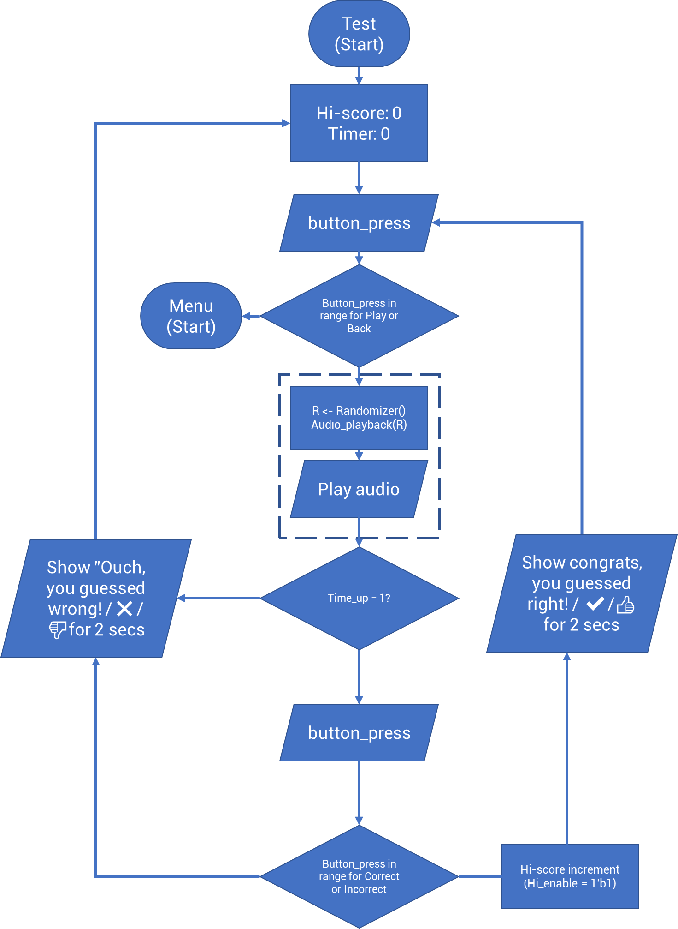

Slide 5
